Slide 1
Instructions for Use
The materials contained within this deck are intended for internal reference only.
If you have questions or would like more information, please contact Kelly OConnor.
Last updated October 2022

Slide 2

Technical overview Azure Database for PostgreSQL

Slide 3
Agenda
Overview
High Availability & Business Continuity
Performance & scale
Security and compliance
Manageability, monitoring & tuning
Azure integration
Common workload patterns
Notes:
Operating a managed Open Source database on Azure
Is my database compliant?
How do I:
Manage hardware purchasing and management?
Protect my data?
Make sure that my database is always available?
Protect my customers against DR scenarios?
Secure my customers’ data against malicious users and mistakes?
Roll out updates, upgrades, and security patches?
Monitor, troubleshoot, and manage at scale?
Tune and maintain my database for predictable performance?

Slide 4
Azure builds upon the core benefits of PostgreSQL
Security
Intelligent performance
Global reach
Modern transactional apps
Compliance
Time series data
Geospatial apps
Extension support
Easy to scale
Azure Database for PostgreSQL is fully-managed, intelligent, and scalable PostgreSQL
Easy ecosystem integration
Built-in HA

Slide 5

The benefits of Azure Database for PostgreSQL
Build or migrate your workloads with confidence and optimize for value
Highly available and flexible managed database
Migrate to fully managed open source PostgreSQL
Optimize value with a lower total cost of ownership
Simplified developer experience
Advanced data security and compliance
Focus on application innovation with a fully managed, highly available PostgreSQL database, that provides maximum flexibility including zone redundant high availability, custom maintenance windows and AI powered performance optimization
Migrate with ease using a fully managed PostgreSQL databases with support for latest versions. Build with your favorite PostgreSQL extensions and Microsoft’s open-source resources including PostgreSQL extension for Azure Data Studio.
Save up to 62%¹ on a lower total cost of ownership when migrating and modernizing to Azure. Leverage stop/start features, burstable, and reserved instances and only pay for storage when your database is stopped.
Increase productivity with simplified end to end deployment experience. Utilize tight integration with PostgreSQL extensions. Reduce time to market with integration with Azure Kubernetes Service, Azure App Service and more.
Protect your data with enterprise-grade security and compliance, and enhanced security capabilities of Azure Defender and double encryption.
Notes:
¹https://azure.microsoft.com/en-us/resources/analyzing-the-economic-benefit-of-migrating-from-on-premises-instances-to-azure-database-for-postgresql/

Slide 6
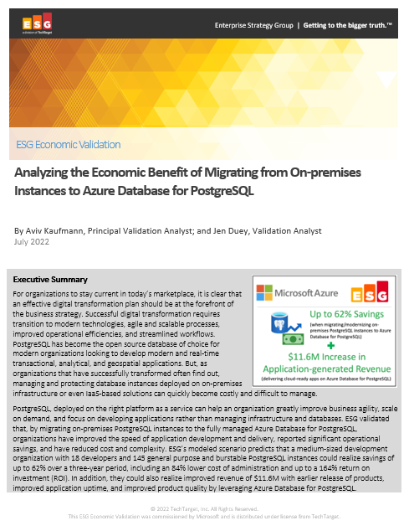
Significantly reduce cost when migrating workloads to PaaS
Key report benefits and findings¹
Up to 62%
Cost savings when migrating on-premises PostgreSQL instances to Azure Database for PostgreSQL
Microsoft commissioned Enterprise Strategy Group to conduct an Economic Value study to examine potential cost savings and business benefits enterprises would achieve from migrating on-premises workloads to Azure Database for PostgreSQL.
Modernizing on Azure Database for PostgreSQL yields even greater benefits…
+$11.6M
Additional revenue due
to improved development capacity
68%
Lower TCO compared to on premises PostgreSQL deployments
164%
based on the expected savings and benefits
$13.1M
Expected savings over three years
1 Results are based on interviewed customers. “Analyzing the Economic Benefit of Migrating from On-premises Instances to Azure Database for PostgreSQL,” a commissioned study conducted by The Enterprise Strategy Group on behalf of Microsoft, July 2022.
Notes:
We partnered with the Enterprise Strategy Group to validate the cost savings, operational efficiency, and improved business agility that customers reported when migrating their on-premises MySQL instances to Azure Database for MySQL Flexible Server and the TOP-LEVEL FINDINGS from ESG’s model FOUND THAT Azure Database for MySQL provided UP TO a 48% LOWER TOTAL COST over a three-year period to deliver the services to host, secure, and protect MySQL instances.
This included an enormous 93% reduction in the operational cost to deploy, manage, and maintain MySQL instances on an on-premises environment. Azure Database for MySQL offloads the majority of the work currently performed by developers, which reduces the EXPECTED cost to administer, tune, secure, protect, and maintain the MySQL databases by UP TO 86%.
These savings equate to roughly 4 full-time developers’ worth of PRODUCTIVITY SAVED, which equates to a 20% increase in development capacity, resulting in $15.5M dollars in additional expected revenue for the organization.
This is a perfect example of how Azure managed open source databases can reduce your total cost of ownership when migrating your workloads to Azure.

Slide 7
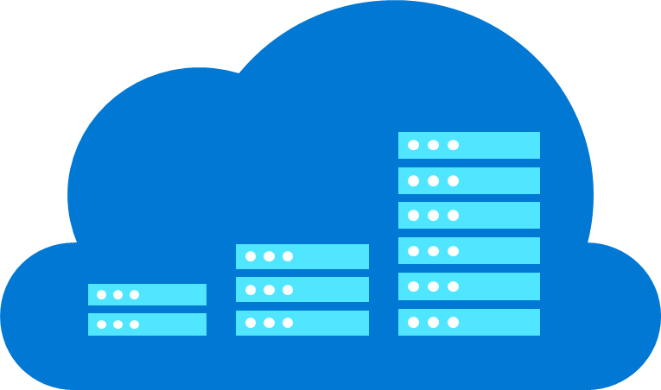
Easy to build with a fully-managed service on Azure
Automatic updates
Scale in seconds
Built-in compliance and security
Azure IP Advantage
Azure ensures your data is available and automatically updates your database, freeing you to focus on your application
Scale your compute or storage resources independently to meet your application’s needs
Automatically leverage enterprise grade security and compliance; proactively receive security alerts with Advanced Threat Protection
Rest assured that you have best-in-industry uncapped defense and indemnification coverage

Slide 8


Azure Database for PostgreSQL | Top Use Cases
Migration
Cloud-Native Applications
Homogeneous Migration
Oracle to Postgres Migration
Transactional applications
Geospatial aware applications
SaaS
applications
Seamless migration experience leveraging high performance and secure Azure Database for PostgreSQL
Complete migrations faster and realize significant cost savings
Engage cloud native developers with the flexibility of AKS and extensibility of PostgreSQL
Leverage PostGIS, the world’s most popular OS geospatial solution to deliver location-aware experiences
Enjoy high-throughput and cloud scalability during peak times for multi-tenant SaaS applications

Slide 9
High availability & business continuity
Use Cases

Slide 10



Built-in basic high availability
PostgreSQL Clients / Applications
Azure Database Management Service
Azure VM
Server
Server
Gateway
…
Secure container
Secure container
Secure container
Secure container
AKS
Azure Storage
X
Data
Data
Data
App Service
Key Features
Basic local resiliency for compute failure within region
AZ-level resiliency with storage failure with 3 copies
Offering
Azure Database for PostgreSQL – Single Server
Challenge
Not Az Aware
Longer downtime (possibly in minutes)
Solved by Flexible Server Muti Az Aware HA

Slide 11
Zone Redundant High Availability (ZR-HA) – Flexible Server
Region-1
Primary
(AZ-1)
A synchronous standby replica automatically deployed in a different availability zone (AZ) than the primary DB deployed AZ.
Zero data loss in the event of a planned or unplanned failover
Physically separate synchronous copy of data maintained using Postgres streaming replication
Automatic failure detection and failovers using internal monitoring mechanisms
High uptime during planned and unplanned outages
Standby
(AZ-2)

Slide 12


Zone Redundant HA – Flexible Server
Region – East US
Availability Zone 1
5
Availability Zone 2
Flexible Server (Primary)
Flexible Server (Standby)
Linux VM
1
Linux VM
Azure VM
PostgreSQL
Synchronous Replication
PostgreSQL
Azure VM
AKS
2
AKS
Premium Storage
Premium Storage
Data, WAL
Data, Logs
App Service
App Service
Daily data backups
Zone-redundant backup storage
WAL archival
3
4
Postgres streaming replication
Ack once the logs are persisted on disk
Snapshot backups from primary
Continuous WAL archival to BLOB
Automatic failover
1
2
3
4
5

Slide 13
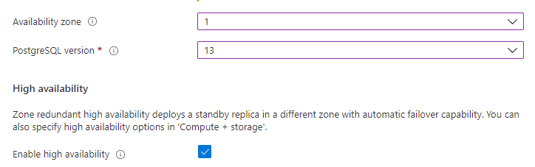
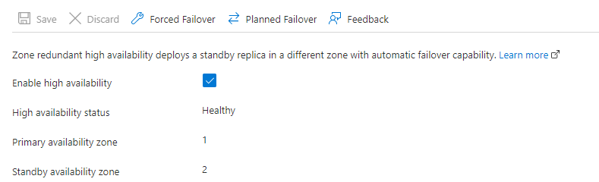
Zone-Redundant High Availability – Flexible Server
At the time of create
If provisioned in a VNET, both primary and standby will be in the same VNET
High data resiliency with physically separate synchronous copy of data with 3 data block copies in each site
Automatic failover to standby during unplanned outages and during managed maintenance window updates
Zero data loss after a failover
Ability to withstand server / AZ-level failures
Planned operations like scale compute/scale storage to take advantage of standby-first post-GA
Restrictions – no support for unlogged tables, Burstable SKUs. Limited support with logical replication (see doc)
Post-create view/update

Slide 14
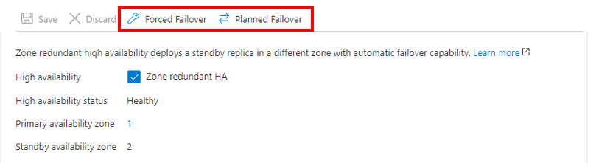
On-demand Failover – Flexible Server
Forced Failover
To simulate a fault in the primary
Failover is triggered
Observe the application downtime during the failover process
The end-to-end operations reported includes new standby creation & establishing a steady-state
So, you may see the failover taking very long
But check the application downtime. That is usually < 2 minutes.
Planned Failover
Use this option if you want to bring the server to the preferred Availability zone.
Provides much lesser overall downtime
The overall end-to-end operations may show longer.

Slide 15
Disaster recovery – protection from regional failures
North America (regional pair)
East US
West US
Geo-redundant backup / restore
DR across selected paired region
Logical replication-based DR
Replica - Physical replication
Will be a managed service
Low-cost DR
On-demand DR instance creation
Lower RTO/RPO
Logical repl. restrictions apply
Replicate to same or any region
Customer managed
Replicate to same or any region
Low RTO/RPO
Higher RTO/RPO
Single Server ONLY*
AZ1
AZ2
AZ1
AZ2
AZ3
AZ3
Canada Central
AZ1
AZ2
To any region (replication)
AZ3

Slide 16
Geo-Redundant Backup
Region – East US 2
Region – Central US
Flexible Server (DR)
Flexible Server (Prod)
Linux VM
PostgreSQL
PostgreSQL
Azure VM
Azure VM
AKS
AKS
Premium Storage
Storage
Data, Logs
Data, WAL
App Service
App Service
2
Daily databackups and continuous WAL backup
Geo-redundant backup storage
On-Demand Restore
1
Paired region DR

Slide 17
Geo-Redundant Backup
Region – East US 2
Region – Central US
Flexible Server (Prod)
Flexible Server (DR)
Azure VM
PostgreSQL
PostgreSQL
Azure VM
AKS
AKS
Storage
Storage
Backup
Data, WAL
Data, Logs
App Service
2
App Service
Geo-redundant backup storage
1
On-Demand Restore
Paired region DR

Slide 18
Geo-Redundant Backup
Geo-Redundant backups
Initially will be available in limited regions in Preview
Provides low-cost DR capability
No servers running at the DR location
Geo-Backup
Currently only create-time experience
Backup to a paired region
Daily full backups + WAL files shipped to paired region
Delay could be up to 1 hr (RPO)
Geo-Restore
On-demand restore at the paired region
RPO with up to 1hr of potential data loss
Region – East US 2
Region – Central US
Flexible Server (Prod)
Flexible Server (DR)
Azure VM
PostgreSQL
PostgreSQL
Azure VM
AKS
AKS
Storage
Backup
Storage
App Service
App Service
Data, WAL
Data, Logs
2
Geo-redundant backup storage
1
On-Demand Restore
Paired region DR

Slide 19
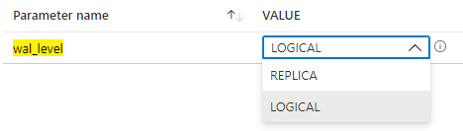
Logical replication / decoding (Use cases)
Granular replication than physical replication
DB-level, table-level replication between two r/w servers
To be managed by customers
Logical replication restrictions apply
Native logical replication*
Between PostgreSQL versions 10 and above
Between Flexible Servers
Between on-premises and Flexible server
PgLogical extension*
Similar to native logical replication
Better performance
Additional capabilities – like DDL support
Logical decoding
WAL2JSON / Test Decoding to copy data to another Postgres or a different DB engine
Can use with Debezium for CDC
Logical mode captures more WAL data
Can be used with physical replica
*Flexible Server only
Notes:
Table schema and DDL
pglogical can copy initial schema of the database while when using built-in logical replication, it’s necessary to create the tables beforehand manually. Also, pglogical provides pglogical.replicate_ddl_command function to ensure that DDL statement is replicated to the subscribers at correct place in replication stream (so that the DDL does not break replication).
The built-in PosgreSQL logical replication does not have any provisions to help maintaining the database schema.

Slide 20
Performance & scale
Use Cases

Slide 21
Read replicas to scale out workloads
Master
Asynchronous replication
Up to 5 Read Replicas
…
…
Application
BI and Analytics Reporting
Dashboard
Notes:
Reference:
https://docs.microsoft.com/en-us/azure/postgresql/concepts-read-replicas
https://docs.microsoft.com/en-us/azure/postgresql/howto-read-replicas-portal

Slide 22
Extensions authored / maintained by Microsoft
Scales out Postgres across multiple nodes via sharding & replication
Columnar storage for analytics with Postgres
Implementation of HyperLogLog for fast accurate distributed distinct counts
Cron-based job scheduler to Run periodic jobs in PostgreSQL
Efficiently return top items in a very large dataset
Citus
cstore_fdw
hll
pg_cron
topN

Slide 23
Security & Compliance
Use Cases

Slide 24


The modern security challenge
43%
Social
No organization is immune
More frequent attacks
More sophisticated techniques
76% of breaches were financially motivated
28% involved internal actors, while 72% were perpetrated by outsiders
51% Malware
81% Stolen/Weak Passwords
14% Errors
62% Hacking
14% Privilege Misuse
8% Physical Actions
Source: Verizon 2017 & 2018 Data Breach Investigations Report
Notes:
These statistics come from the latest Verizon Breach Investigations Report.
As we all know, attacks are getting more frequent and sophisticated. Most breaches are perpetrated by outsiders (72%), but that means 28% come from internal sources.
Protecting personal data requires a combination of strong privacy policies and strong security measures, which are necessary to counter malicious, as well as inadvertent behavior.

Slide 25
Data Security Lifecycle
Supported on Single Server
Coming to Flexible Server in 2022
Discover
Protect
Vulnerability Assessment
Manage security baseline
Security recommendations
Discover security misconfigurations
Data Encryption
Encrypt data at transit (TLS)
Encrypt data at rest (AES 256)
Access Control
Configure firewall rules/VNET
Authenticate access
Detect
Azure Defender*
Detect suspicious activity
Remediation actions
Notes:
You can look at SQL data security work as an ongoing lifecycle that starts with:
Discovering sensitive data and security misconfigurations using Data Classification and Vulnerability Assessment
Taking proactive actions to protect the sensitive data using Encryption and access controls
Ongoing response to suspicious activities data using Threat Detection and Auditing
In this session, I will focus on the security intelligent capabilities, which are part of our SQL ATP suite and marked in yellow.

Slide 26
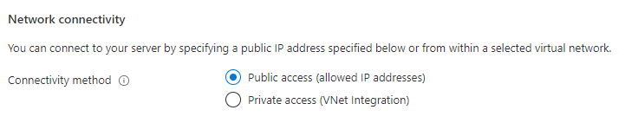

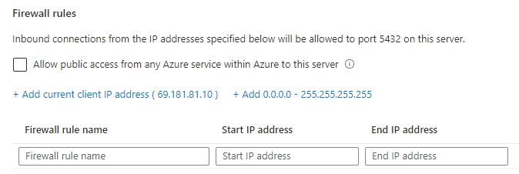

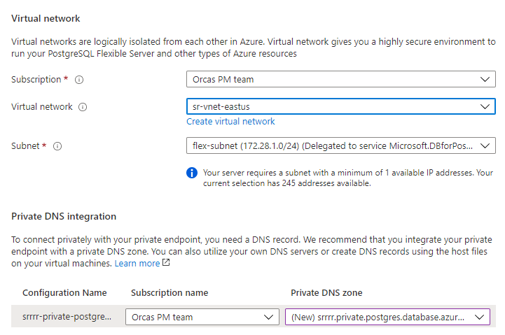
Control Network Isolation & Security
Public access
Restricted by firewall rules
Add client access list
Private access (Virtual Network)
Inject Flexible servers to a delegated subnet
Client can be in the same VNET or a different VNET in the same region or a different region (VNET peering)

Slide 27
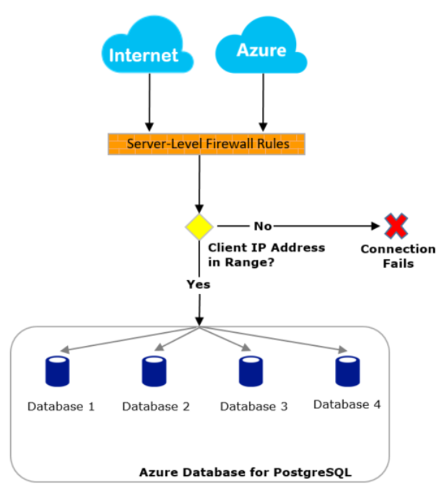
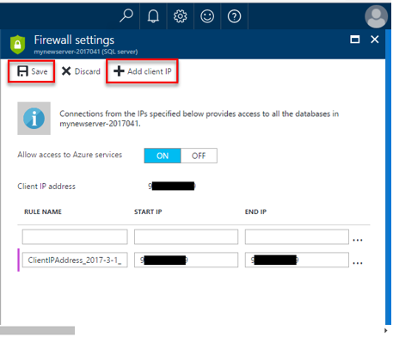
Access control provide additional security
Azure
2
SSL/TLS 1.2
SSL/TLS 1.2
SSL/TLS 1.2
Internet
1
Firewall
Native auth
1
SSL / TLS 1.2 is enforced.
Server firewall prevents all access to your database server until you specify which computers have permission.
Configure firewall to allow all connections from Azure including connections from the subscriptions of other customers. Make sure your login and user permissions limit access to only authorized users.
2
3
3
3
Notes:
Connectivity is SSL / TLS 1.2
Firewall does not enable any access by default. You must specify IP for access to the database.
Allow Azure Services reduces the need to create many rules and ranges however, opens traffic to all Azure service including other tenants.

Slide 28
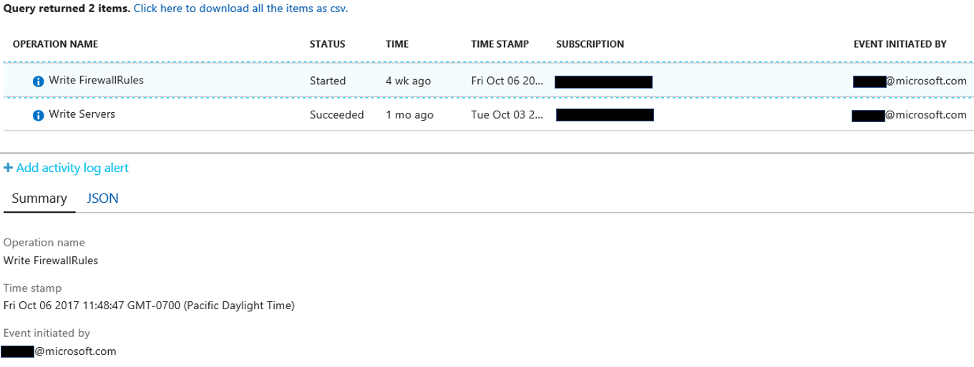


Data encryption and logging ensures protection
Azure
1
Encryption of data at rest is AES 256 bit, system managed and always on.
Built in activity logging facilitates security monitoring. Native OMS integration.
2
SSL/TLS 1.2
SSL/TLS 1.2
SSL/TLS 1.2
Internet
Firewall
Native auth
Firewall example:
Log Analytics
Azure Storage AES 256 bit
2
1
“properties”:{ “requestbody”: “{\”value\”:[{\”name\”:\”Test\”,\”properties\”:{\”startlpAddress\”:\”10.1.1.1\”,\”endlpAddress\”:\”10.1.1.2\”}}]}”,”statusCode”: “Accepted”,
Notes:
Encryption is always on, no way to disable it, AES 256 bit, keys are system managed and heavily defended / monitored. Not publicly or internally accessible. Key rotation is a permissive, logged and monitored internal operation. Firewall rules and activities are logged. Activity logs can be downloaded. Integration with OMS is not available…. yet. However, manually exporting them to OMS Log Analytics is possible and recommended.

Slide 29

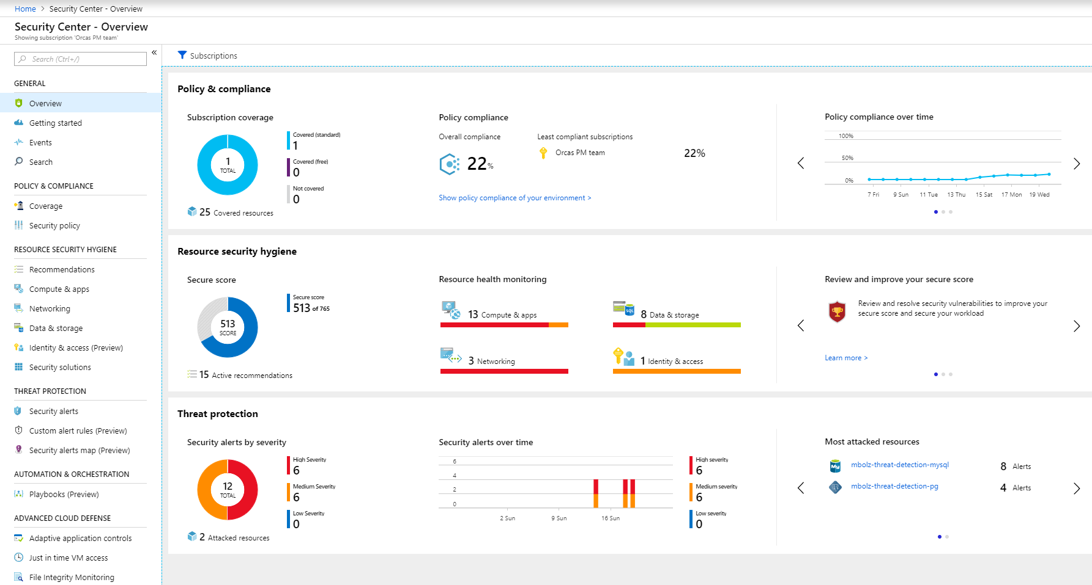
Azure Defender
Supported on Single Server
Coming to Flexible Server in 2022
Learns from millions of databases
Analysis across all Azure data services world-wide
Uses AI and ML to continuously enhance models
Sends alerts with
Intelligent recommendations
Prescriptive actions
Monitor your servers
Unfamiliar source locations
Brute force attacks
Suspicious users
SQL injection

Slide 30


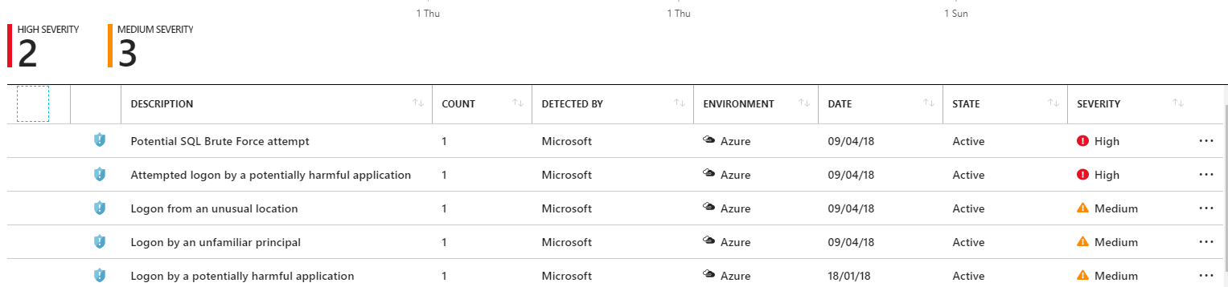
Azure Defender Detect unusual and harmful attempts to breach your database
Supported on Single Server
Coming to Flexible Server in 2022
Just turn it ON
Detects anomalous access (e.g. brute force, location, app, user..,)
Actionable alerts to investigate & remediate
View alerts for your entire Azure tenant using Azure Security Center
Attacker
(2) Possible threat to access / breach data
User
Apps
Azure PostgreSQL
Advanced Threat Protection
Developer
(1) Turn on Advanced Threat Protection
(3) Real-time actionable alerts
Notes:
Azure PostgreSQL threat detection provides an additional layer of security intelligence which detects suspicious activities going on in the database.
A simple way to enable threat detection using Azure portal, which requires no modifications to existing application code or client applications.
A proprietary set of algorithms that work around the clock to learn, profile and detect suspicious databases activities, indicating a potentially harmful attempts to access or exploit data in the database.
Someone has logged from an unusual location - change in the access pattern from an unusual geographical location
An unfamiliar principal successfully logged- - change in the access pattern using an unusual SQL user.
Someone is attempting to brute force SQL credentials abnormally high number of failed logins with different credentials.
Someone has logged from a potentially harmful application
It provides actionable alerts over email and in Azure portal which provides details of the suspicious activity and recommends how to further investigate and mitigate the threat.
----------------------------------------------------------
We are embedding machine learning directly into our cloud services to deliver intelligent data services that keep your data safe. For example, consider the security features in Azure SQL DB
Our ML systems analyze and learn from over 700 TB data/per day to ensure we keep your applications highly efficient and data safe – through automatic auditing and threat detection. With active Threat Detection, the service can identify anomalies in your workload and alert you of a potential attack like SQL injection. The service does the hard work so you don’t have to – so you can focus on the business problems you’re solving and creating breakthrough applications.
---------------------------------------------------------------------------------------------------
SQL Threat Detection allows you to detect suspicious activities indicating a possible malicious intent to access, breach or exploit data in the database. SQL Database Threat Detection runs multiple sets of algorithms which detect potential vulnerabilities and SQL injection attacks, as well as anomalous database access patterns (such as access from an unusual location or by an unfamiliar principal). Security officers or other designated administrators get email notification once a threat is detected on the database. Each notification provides details of the suspicious activity and recommends how to further investigate and mitigate the threat.
“Azure SQL Database Threat Detection is now generally available Threat Detection leverages machine learning to provide an additional layer of security built into the SQL Database service, enabling SQL Database customers to protect their databases within minutes without needing to be an expert in database security. It works around the clock to profile and alert you of anomalous activities on your databases. Threat detection alerts can be viewed from Azure Security Center and provide details of suspicious activity and recommend action on how to investigate and mitigate the threat. To learn more about Threat Detection, including pricing, visit the Azure blog.

Slide 31






Security & Compliance
Security built-in with native and AAD integration
Control access with secure SSL, server firewall rules, and VNET
Built-in encryption for data and backups in-motion and at-rest
Protect your data with up-to-date security and compliance features using the Azure IP Advantage
Leading compliance offerings (SOC, ISO, CSA STAR, PCI DSS, HIPAA, etc.)
SOC 2
Type 2
Level 1
CSA STAR
Certification
Notes:
Protecting your innovation in the cloud: Reduce risk, innovate with confidence, and operate with freedom in the cloud. Azure IP Advantage provides the industry’s most comprehensive protection against intellectual property (IP) risks.
-Best-in-industry intellectual property protection
-Build confidently with uncapped indemnification
-Deter and defend lawsuits with patent pick
-Get broad protection with a springing license
Based on customer demand from various industry verticals
SOC2 - Service Organization Controls standards for operational security
ISO 27001 - Information Security Management Standards
ISO 27018 - Code of Practice for Protecting Personal Data in the Cloud
CSA STAR - Cloud Security Alliance: Security, Trust & Assurance Registry (STAR)
PCI DSS Level 1 - Payment Card Industry (PCI) Data Security Standard (DSS) Level 1 Service Provider
HIPAA / HITECH Act - Health Insurance Portability and Accountability Act / Health Information Technology for Economic and Clinical Health Act
ISO 27017:2015 - Code of Practice for Information Security Controls
ISO 9001:2015 Quality Management Systems Standards
ISO 22301:2012 Business Continuity Management Standard
ISO/IEC 20000-1:2011 Information Technology Service Management

Slide 32
Manageability, monitoring, and tuning
Use Cases

Slide 33
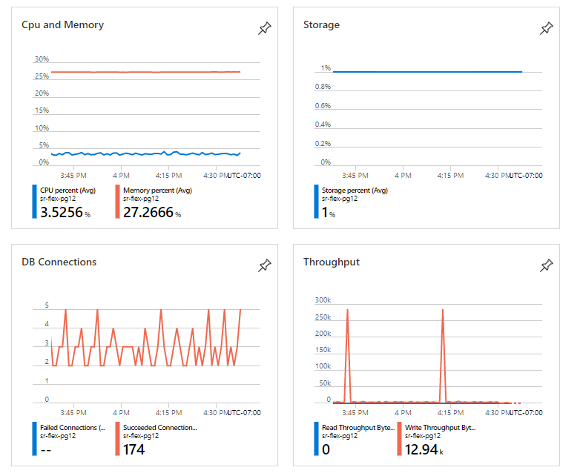
Monitoring - Metrics
Metrics shown in the overview page
See additional details in the metrics page
Traffic
Connections, network In/out, etc.
Saturation
CPU, memory, storage, IOPS, throughput etc.
Errors
Failed connections

Slide 34
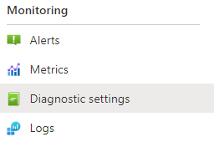
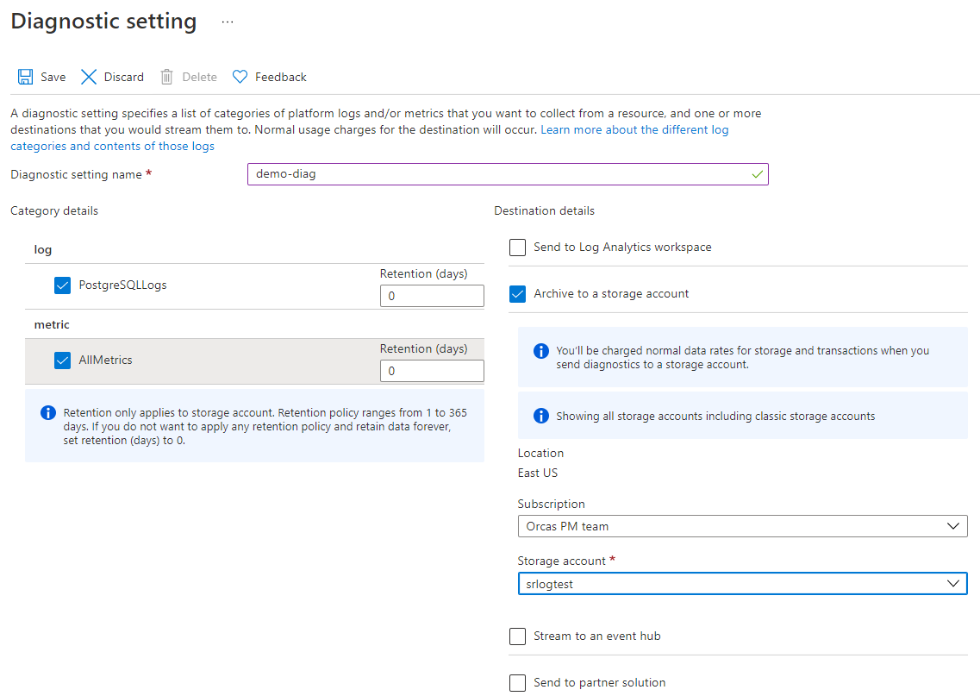
Monitoring – Postgres logs
Configure in Diagnostic Settings in the Portal
Ability to choose the retention days
Flexibility to
Send to Log analytics workspace
Archive to storage account
Stream to event hub
Send to partner solution
Apache Kafka
Datadog
Elastic
Use Azure Storage Explorer to view the logs

Slide 35
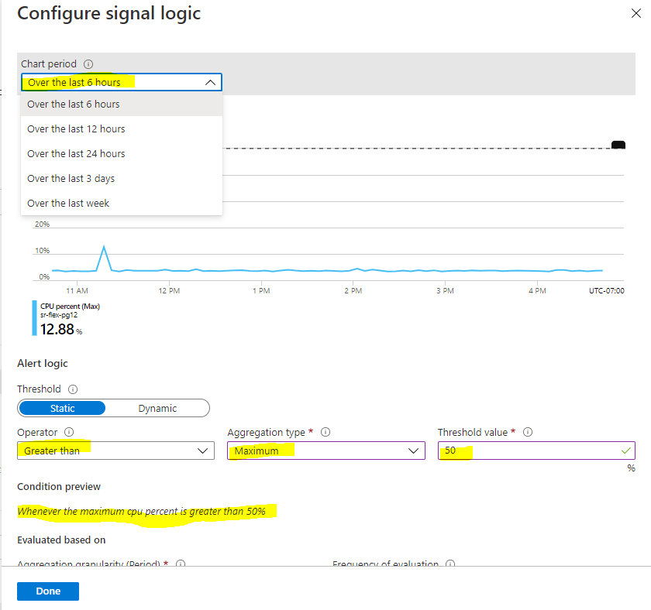
Alerts
Define condition & action
Condition
CPU, storage, memory, IOPS etc.
Example: CPU exceeds %
Action
Create action group
Email/SMS/Push/Voice

Slide 36
Best practices for metrics
Monitor storage_used and storage_percent. Remember to configure alerting.
The server is marked read-only when the amount of free storage reaches less than 5 GB or 5% of provisioned storage, whichever is less.
The storage provisioned is used for database data, transaction logs and server logs.
Scale up storage size before hitting the limit. The service allows you to increase storage elastically with no application impact.

Slide 37
Best practices for metrics
Monitor io_consumption_percent and remember to configure alerting.
IOPS scale with provisioned storage with minimum of 100 IOPS (5-32GB) and then scales linearly at approximately 3 IOPS per GB
IOPS does not scale beyond 2 TB (6000 IOPS)
Each IOP can be up to 256 KB
io_consumption_percent at 100% would cause excessive throttling impacting database performance.
Scale up storage size before hitting the limit. The service allows you to increase storage elastically with no application impact.
Evaluate/tune indexes and queries as necessary.

Slide 38
Best practices for metrics
Monitor cpu_percent and memory_percent, and remember to configure alerting.
Memory usage should be mostly consistent at steady state.
Key drivers for excessive memory usage are number of connections, or non-optimal query execution.
Opening and closing connections may drive excessive CPU usage. Consider using connection pooling.
Scale up compute before hitting the limit. The service allows you to dynamically scale compute up or down. Memory scales per vCore and consider using Memory Optimized tier for better price/performance.
High CPU usage is not the only indicator of CPU bottleneck. Watch out for those single threaded jobs!

Slide 39
Best practices for metrics
Monitor network latency between application VM and the database. Measure with SELECT 1 tests from the client.
Average network latency should be < 2ms
Ensure application and database server are in the same region, created within the same resource group
Configure VM (hosting the application) with accelerated networking

Slide 40
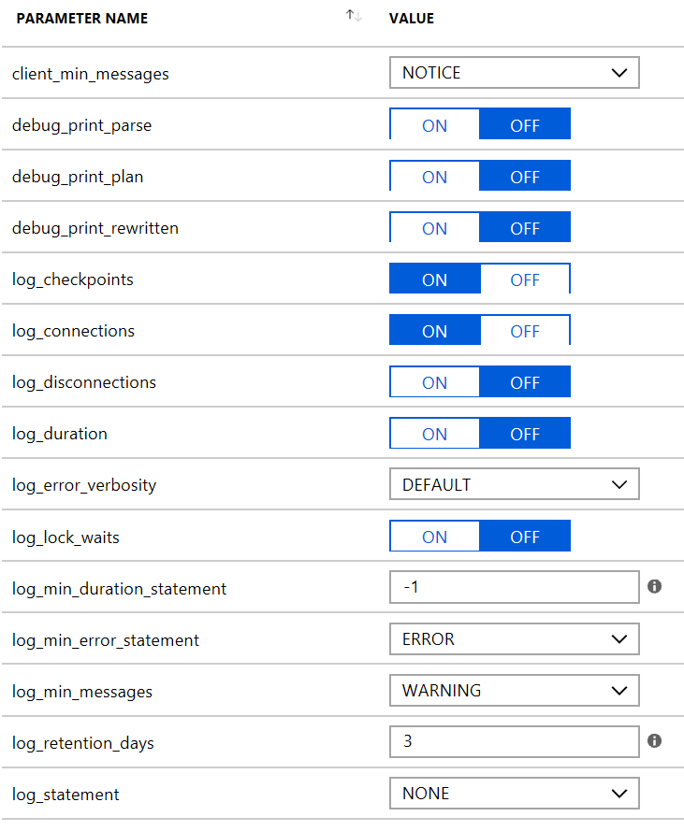
Server Logs (PostgreSQL)
Built-in server logs for troubleshooting database errors or performance issues
Configure log_retention_days (3-7 days) to define the retention period for system logs
Configure log_statement to “ALL” for analyzing performance issues
log_min_duration_statement lets you specify the minimum execution time (in milliseconds) above which statements will be logged.
Consumes server provisioned storage
The log files rotate every one hour or 100 MB size, whichever comes first.
Measure the impact of excessive logging and increase verbosity only during troubleshooting.

Slide 41
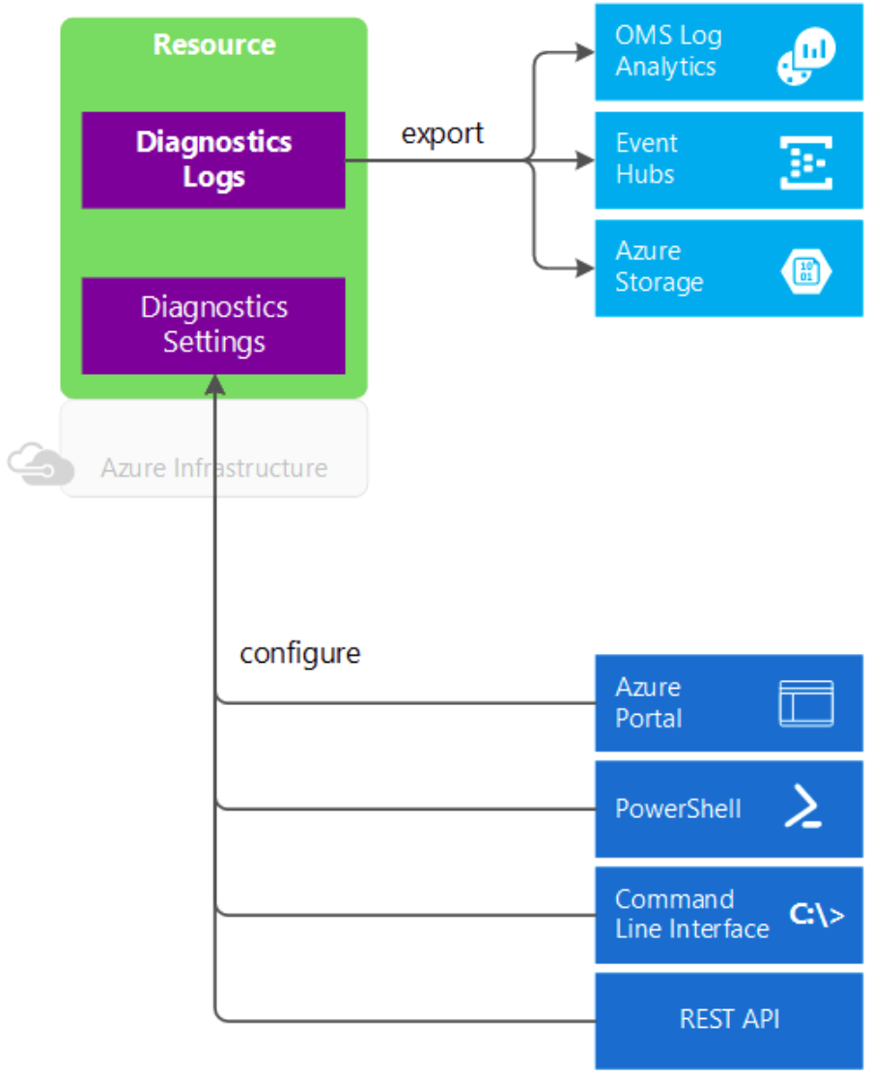
Announcing integration of server logs with Azure Monitor
Integrated with Azure Monitor (Diagnostic logs) for optional ability to:
Route to OMS Log Analytics to enable instant analytics
Stream server logs to event hub for ingestion by a third-party service or custom analytics solution such as PowerBI
Archive server logs to blob storage for compliance, auditing or manual inspection

Slide 42
Maintaining and optimizing database performance
Is important for:
End-user experience
Business success
Is difficult because:
It requires significant expertise
Most database users are developers, not DBAs
Changing workloads
Typically reactive in nature
?
Notes:
There are a number of different factors that can lead to database performance issues, and some of them happen regularly during application lifecycle – changes to the application, changes to the data size and distributions, etc.
DB Performance management is one the hardest challenges when running a DB application, for the following reasons:
It can have huge impact to the application/business - in the most critical case entire app or website is down because of slow or unresponsive database. In that case business losses can be huge and problem must be fixed ASAP.
It’s a very complex problem space - requires deep understanding of how the database engine works.
Today performance management is largely reactive since most of the SQL DB customers are developers. They typically do not have the expertise required to find and fix the DB performance issues before they escalate, or to proactively tune the performance on their DBs
This leads to lots of anxiety, both for the Users and for the Developers
So how do we make achieving great performance easy for the customers?

Slide 43
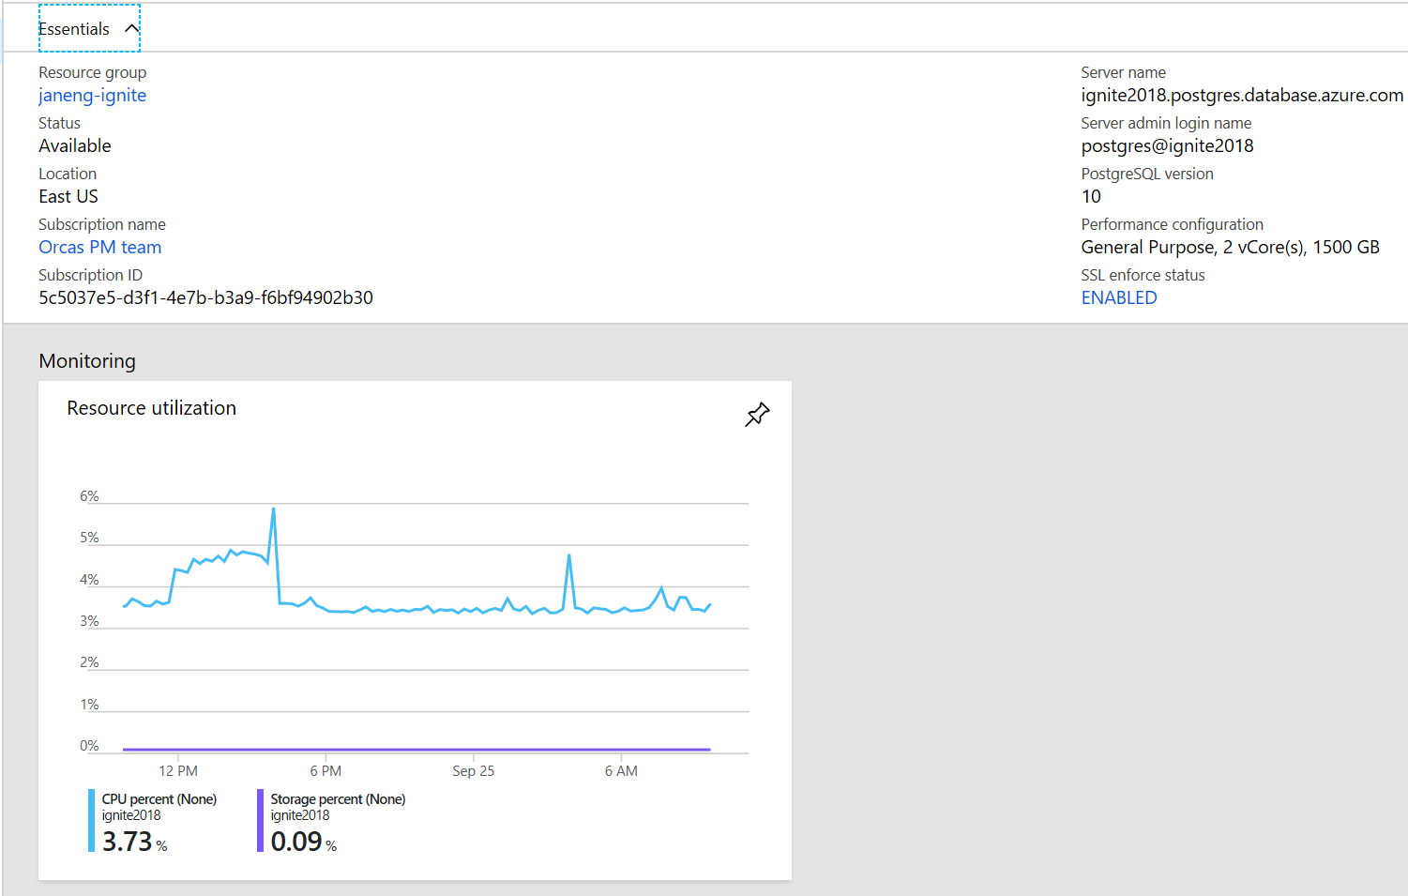
Why does it have to be so hard?
pg_stat_*
Server logs
pg_stat_statements
pg_stat_activity
pg_stat_archiver
pg_stat_bgwriter
pg_stat_database
pg_stat_database_conflicts
pg_stat_all_tables
pg_stat_sys_tables
pg_stat_user_tables
pg_stat_xact_all_tables
pg_stat_xact_sys_tables
pg_stat_xact_user_tables
pg_stat_all_indexes
pg_stat_sys_indexes
pg_stat_user_indexes
pg_statio_all_tables
pg_statio_sys_tables
pg_statio_user_tables
pg_statio_all_indexes
pg_statio_sys_indexes
pg_statio_user_indexes
pg_statio_all_sequences
pg_statio_sys_sequences
pg_statio_user_sequences
pg_stat_user_functions
pg_stat_xact_user_functions
2018-09-24 04:03:17 UTC-5ba7ee26.84-LOG: checkpoint starting: time
2018-09-24 04:03:18 UTC-5ba7ee26.84-LOG: checkpoint complete: wrote 16 buffers (0.0%); 0 WA
2018-09-24 04:04:25 UTC-5ba86249.5e4c-LOG: connection received: host=127.0.0.1 port=35043
2018-09-24 04:04:25 UTC-5ba86249.5e4c-LOG: connection authorized: user=MASK_AZURE_USER data
2018-09-24 04:08:17 UTC-5ba7ee26.84-LOG: checkpoint starting: time
2018-09-24 04:08:18 UTC-5ba7ee26.84-LOG: checkpoint complete: wrote 17 buffers (0.0%); 0 WA
2018-09-24 04:09:25 UTC-5ba86375.5f3c-LOG: connection received: host=127.0.0.1 port=35190
2018-09-24 04:09:25 UTC-5ba86375.5f3c-LOG: connection authorized: user=MASK_AZURE_USER data
2018-09-24 04:13:17 UTC-5ba7ee26.84-LOG: checkpoint starting: time
2018-09-24 04:13:26 UTC-5ba7ee26.84-LOG: checkpoint complete: wrote 74 buffers (0.0%); 0 WA
2018-09-24 04:14:25 UTC-5ba864a1.602c-LOG: connection received: host=127.0.0.1 port=35372
2018-09-24 04:14:25 UTC-5ba864a1.602c-LOG: connection authorized: user=MASK_AZURE_USER data
2018-09-24 04:18:17 UTC-5ba7ee26.84-LOG: checkpoint starting: time
2018-09-24 04:18:18 UTC-5ba7ee26.84-LOG: checkpoint complete: wrote 16 buffers (0.0%); 0 WA
2018-09-24 04:19:25 UTC-5ba865cd.6120-LOG: connection received: host=127.0.0.1 port=35697
2018-09-24 04:19:25 UTC-5ba865cd.6120-LOG: connection authorized: user=MASK_AZURE_USER data
2018-09-24 04:23:17 UTC-5ba7ee26.84-LOG: checkpoint starting: time
2018-09-24 04:23:19 UTC-5ba7ee26.84-LOG: checkpoint complete: wrote 16 buffers (0.0%); 0 WA
2018-09-24 04:24:25 UTC-5ba866f9.620c-LOG: connection received: host=127.0.0.1 port=35913
2018-09-24 04:24:26 UTC-5ba866f9.620c-LOG: connection authorized: user=MASK_AZURE_USER data
2018-09-24 04:28:17 UTC-5ba7ee26.84-LOG: checkpoint starting: time
2018-09-24 04:28:26 UTC-5ba7ee26.84-LOG: checkpoint complete: wrote 83 buffers (0.0%); 0 WA
2018-09-24 04:29:25 UTC-5ba86825.62fc-LOG: connection received: host=127.0.0.1 port=36087
2018-09-24 04:29:25 UTC-5ba86825.62fc-LOG: connection authorized: user=MASK_AZURE_USER data
2018-09-24 04:33:17 UTC-5ba7ee26.84-LOG: checkpoint starting: time
2018-09-24 04:33:19 UTC-5ba7ee26.84-LOG: checkpoint complete: wrote 16 buffers (0.0%); 0 WA
2018-09-24 04:34:25 UTC-5ba86951.63f0-LOG: connection received: host=127.0.0.1 port=36244
2018-09-24 04:34:25 UTC-5ba86951.63f0-LOG: connection authorized: user=MASK_AZURE_USER data
2018-09-24 04:38:17 UTC-5ba7ee26.84-LOG: checkpoint starting: time
2018-09-24 04:38:20 UTC-5ba7ee26.84-LOG: checkpoint complete: wrote 22 buffers (0.0%); 0 WA
2018-09-24 04:39:25 UTC-5ba86a7d.64e0-LOG: connection received: host=127.0.0.1 port=36418
2018-09-24 04:39:25 UTC-5ba86a7d.64e0-LOG: connection authorized: user=MASK_AZURE_USER data
2018-09-24 04:39:39 UTC-5ba81853.23b4-LOG: could not receive data from client: An existing
2018-09-24 04:39:39 UTC-5ba7fbd2.c8c-LOG: could not receive data from client: An existing c
2018-09-24 04:43:17 UTC-5ba7ee26.84-LOG: checkpoint starting: time
2018-09-24 04:43:28 UTC-5ba7ee26.84-LOG: checkpoint complete: wrote 101 buffers (0.0%); 0 W
2018-09-24 04:44:25 UTC-5ba86ba9.65d4-LOG: connection received: host=127.0.0.1 port=36688
2018-09-24 04:44:25 UTC-5ba86ba9.65d4-LOG: connection authorized: user=MASK_AZURE_USER data
2018-09-24 04:48:17 UTC-5ba7ee26.84-LOG: checkpoint starting: time
2018-09-24 04:48:19 UTC-5ba7ee26.84-LOG: checkpoint complete: wrote 17 buffers (0.0%); 0 WA
2018-09-24 04:49:04 UTC-5ba86cc0.66b0-LOG: connection received: host=127.0.0.1 port=36861
2018-09-24 04:49:04 UTC-5ba86cc0.66b0-LOG: connection authorized: user=MASK_AZURE_USER data
2018-09-24 04:49:25 UTC-5ba86cd5.66c8-LOG: connection received: host=127.0.0.1 port=36867
2018-09-24 04:49:25 UTC-5ba86cd5.66c8-LOG: connection authorized: user=MASK_AZURE_USER data
2018-09-24 04:49:29 UTC-5ba86cd9.66d0-LOG: connection received: host=127.0.0.1 port=36869
2018-09-24 04:49:30 UTC-5ba86cd9.66d0-LOG: connection authorized: user=MASK_AZURE_USER data
2018-09-24 04:49:31 UTC-5ba86cdb.66d4-LOG: connection received: host=127.0.0.1 port=36871
2018-09-24 04:49:31 UTC-5ba86cdb.66d4-LOG: connection authorized: user=MASK_AZURE_USER data
2018-09-24 04:49:32 UTC-5ba86cdc.66d8-LOG: connection received: host=127.0.0.1 port=36873
2018-09-24 04:49:33 UTC-5ba86cdc.66d8-LOG: connection authorized: user=MASK_AZURE_USER data
2018-09-24 04:49:34 UTC-5ba86cde.66dc-LOG: connection received: host=127.0.0.1 port=36875
2018-09-24 04:49:34 UTC-5ba86cde.66dc-LOG: connection authorized: user=MASK_AZURE_USER data
2018-09-24 04:49:34 UTC-5ba86cdc.66d8-ERROR: could not stat file "base/16387/16391": Permis
2018-09-24 04:49:34 UTC-5ba86cdc.66d8-STATEMENT: select pg_database_size('pgbench')/8192;
2018-09-24 04:49:34 UTC-5ba86cde.66dc-LOG: could not receive data from client: An existing
2018-09-24 04:49:34 UTC-5ba86cdc.66d8-LOG: could not receive data from client: An existing
2018-09-24 04:53:17 UTC-5ba7ee26.84-LOG: checkpoint starting: time
2018-09-24 04:53:22 UTC-5ba7ee26.84-LOG: checkpoint complete: wrote 47 buffers (0.0%); 0 WA
2018-09-24 04:54:25 UTC-5ba86e01.67c8-LOG: connection received: host=127.0.0.1 port=37027
2018-09-24 04:54:25 UTC-5ba86e01.67c8-LOG: connection authorized: user=MASK_AZURE_USER data
2018-09-24 04:58:17 UTC-5ba7ee26.84-LOG: checkpoint starting: time
2018-09-24 04:58:28 UTC-5ba7ee26.84-LOG: checkpoint complete: wrote 104 buffers (0.0%); 0 W
2018-09-24 04:59:25 UTC-5ba86f2d.68b8-LOG: connection received: host=127.0.0.1 port=37168
2018-09-24 04:59:25 UTC-5ba86f2d.68b8-LOG: connection authorized: user=MASK_AZURE_USER data
2018-09-24 04:59:30 UTC-5ba86f32.68c0-LOG: connection received: host=127.0.0.1 port=37171
2018-09-24 04:59:31 UTC-5ba86f32.68c0-LOG: connection authorized: user=MASK_AZURE_USER data
2018-09-24 04:59:32 UTC-5ba86f34.68c8-LOG: connection received: host=127.0.0.1 port=37173
2018-09-24 04:59:32 UTC-5ba86f34.68c8-LOG: connection authorized: user=MASK_AZURE_USER data
2018-09-24 04:59:33 UTC-5ba86f35.68cc-LOG: connection received: host=127.0.0.1 port=37175
2018-09-24 04:59:33 UTC-5ba86f35.68cc-LOG: connection authorized: user=MASK_AZURE_USER data
2018-09-24 04:59:35 UTC-5ba86f37.68d0-LOG: connection received: host=127.0.0.1 port=37177
2018-09-24 04:59:35 UTC-5ba86f37.68d0-LOG: connection authorized: user=MASK_AZURE_USER data
2018-09-24 04:59:36 UTC-5ba86f38.68d8-LOG: connection received: host=127.0.0.1 port=37179
2018-09-24 04:59:36 UTC-5ba86f38.68d8-LOG: connection authorized: user=MASK_AZURE_USER data
2018-09-24 04:59:36 UTC-5ba86f35.68cc-ERROR: could not stat file "base/16387/16391": Permis
2018-09-24 04:59:36 UTC-5ba86f35.68cc-STATEMENT: select pg_database_size('pgbench')/8192;
2018-09-24 04:59:36 UTC-5ba86f35.68cc-LOG: could not receive data from client: An existing
2018-09-24 04:59:36 UTC-5ba86f37.68d0-LOG: could not receive data from client: An existing
2018-09-24 04:59:36 UTC-5ba86f38.68d8-LOG: could not receive data from client: An existing
?
Configuration and utilization
Other factors:
Different client?
Changes to application?
Schema changes?
New data ingested?
and, and, and…
MICROSOFT CONFIDENTIAL – FOR INTERNAL USE ONLY

Slide 44
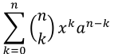
Query Store
Groups based on the structure of the query string
Collects execution statistics
Duration
Resource usage
Wait stats
Aggregates statistics in memory
Persists state every 15 minutes
Retains data in time series
PostgreSQL Server
UserDB
$$\sum_{k=0}^{n}{\left({n \atop k}\right)x^{k}a^{n−k}}$$
SELECT * FROM …
Client
postgres
azure_maintenance
azure_sys
Notes:
Bringing SQL Server IP to OSS
New DB in server (azure_sys)
Server Wide
When processing is happening
Bucketize queries based on structure (‘no values’)
Gathering stats/aggregation on each execution of query bucked in mem
Low in overhead (in mem vs on disk)
Flushed to disk (customer DB) every 15mins -> time series data
Total duration configurable (7 days default, min 1, max 30)
Gathers wait stats per query and stores it in mem as well
PG wait sampling (modified that – took learnings from)
Turned off by default (can be configured through server parameters)

Slide 45
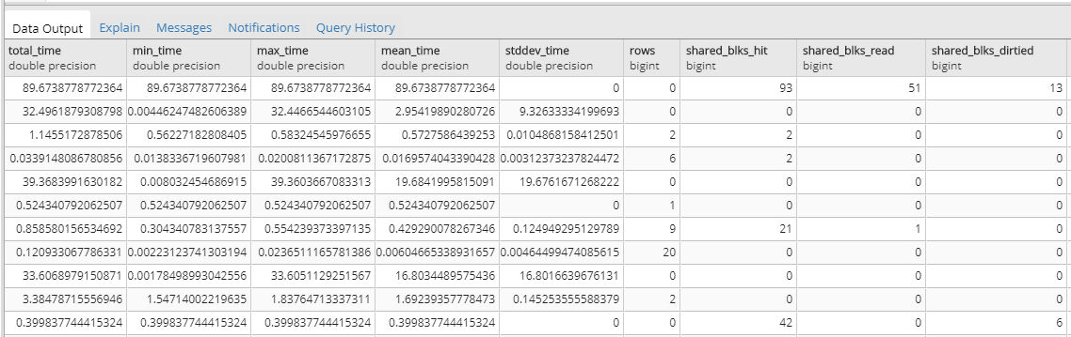
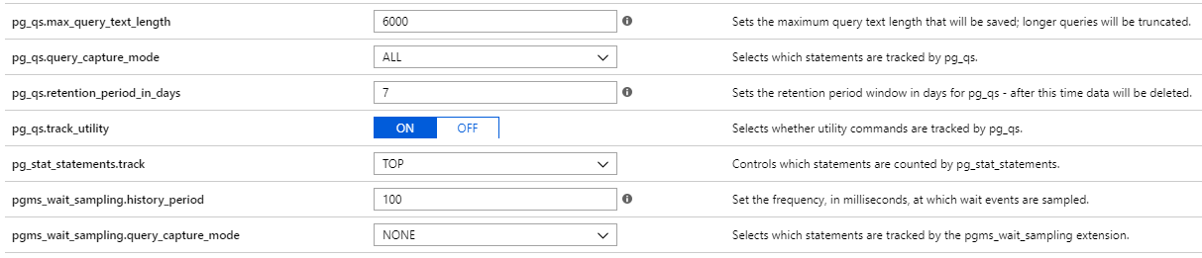
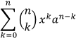
Query Store
Familiar
Reuses pg_stat_statement schema
Reuses pg_wait_sampling schema
Performant
Data stored and aggregated in memory
Flushes the data periodically to disk for persistence
Powerful
Use the full power of SQL to gain insights from the data
Configurable
Capture modes: None, Top, All
Data retention: 1 to 30 days, default 7 days
Wait sampling: Frequency and capture mode
$$\sum_{k=0}^{n}{\left({n \atop k}\right)x^{k}a^{n−k}}$$
azure_sys
SELECT * FROM query_store.qs_view AS qs
JOIN query_store.pgms_wait_sampling_view AS ws ON qs.query_id = ws.query_id
GROUP BY … ORDER BY …

Slide 46
Sample scenarios enabled by Query Store
Workload tuning
Identify longest running queries
Identify top resource-consuming queries
Detect changes over time
Identify and improve ad hoc workloads
A/B testing
Rolling out a new version of an application
Changing the server resources
Creating missing indexes on tables referenced by expensive queries
Query Store
Workload tuning
A/B testing

Slide 47
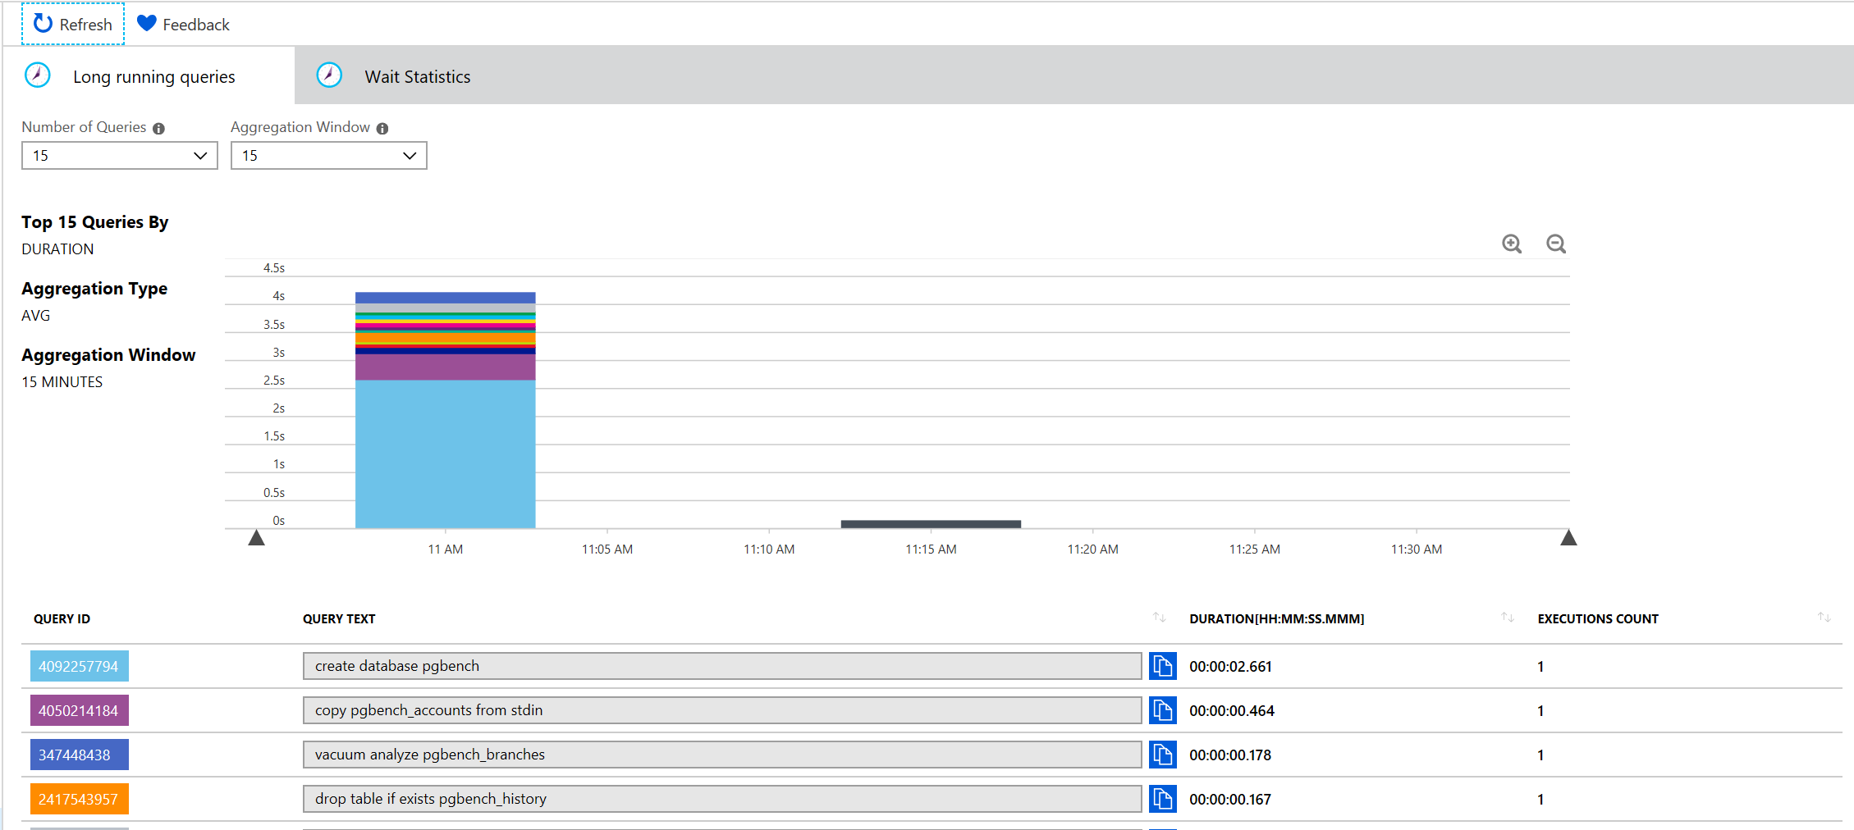
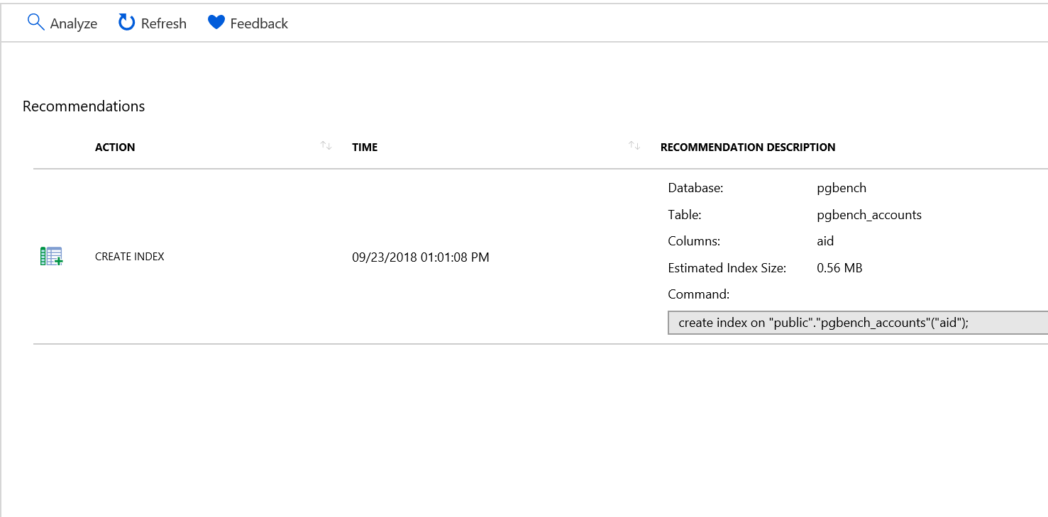
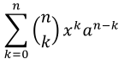
Intelligent Performance
Query performance insights
Visualization of data in Query Store
Performance recommendations
Analysis Query Store data for possible workload optimizations
Step 1: Index recommendations
PostgreSQL Server
UserDB
$$\sum_{k=0}^{n}{\left({n \atop k}\right)x^{k}a^{n−k}}$$
postgres
azure_maintenance
azure_sys
Notes:
Step 1:
Finds query with high I/O footprint
Uses hypopg to estimate is indexes can help
Considers impact of write operations, size of index and impact on other queries
Query performance insights (visualization of query store)
Entry level
Execution time per query over time (long running queries)
Wait stats over time per query
Performance Recommendations
Per database analysis
Checks all queries and tries to identify what queries needs indexes
Analyzes what if there was an index vs not (estimates)
‘EXPLAIN statement’ for baseline
Using hypopg to generate a plan as if there was an index and then run explain again to compare
Considers additional cost of having index
Smart search to make sure all queries are considered and analyzed for impact
Also estimates the additional size needed on storage
Will also output impact due to index (high, med, low – in October)

Slide 48
Azure integration
Use Cases

Slide 49







Innovate with the Azure ecosystem
Easily spin up a database for popular Java, Python and php based applications through Azure Kubernetes Service or Azure App Service
Leverage GitHub actions to deploy updates to your database by enabling simpler and faster innovation with integrated Azure technologies
Develop applications with platforms like Magento, Shopify, Moodle, Alfresco, Drupal and WordPress

Slide 50
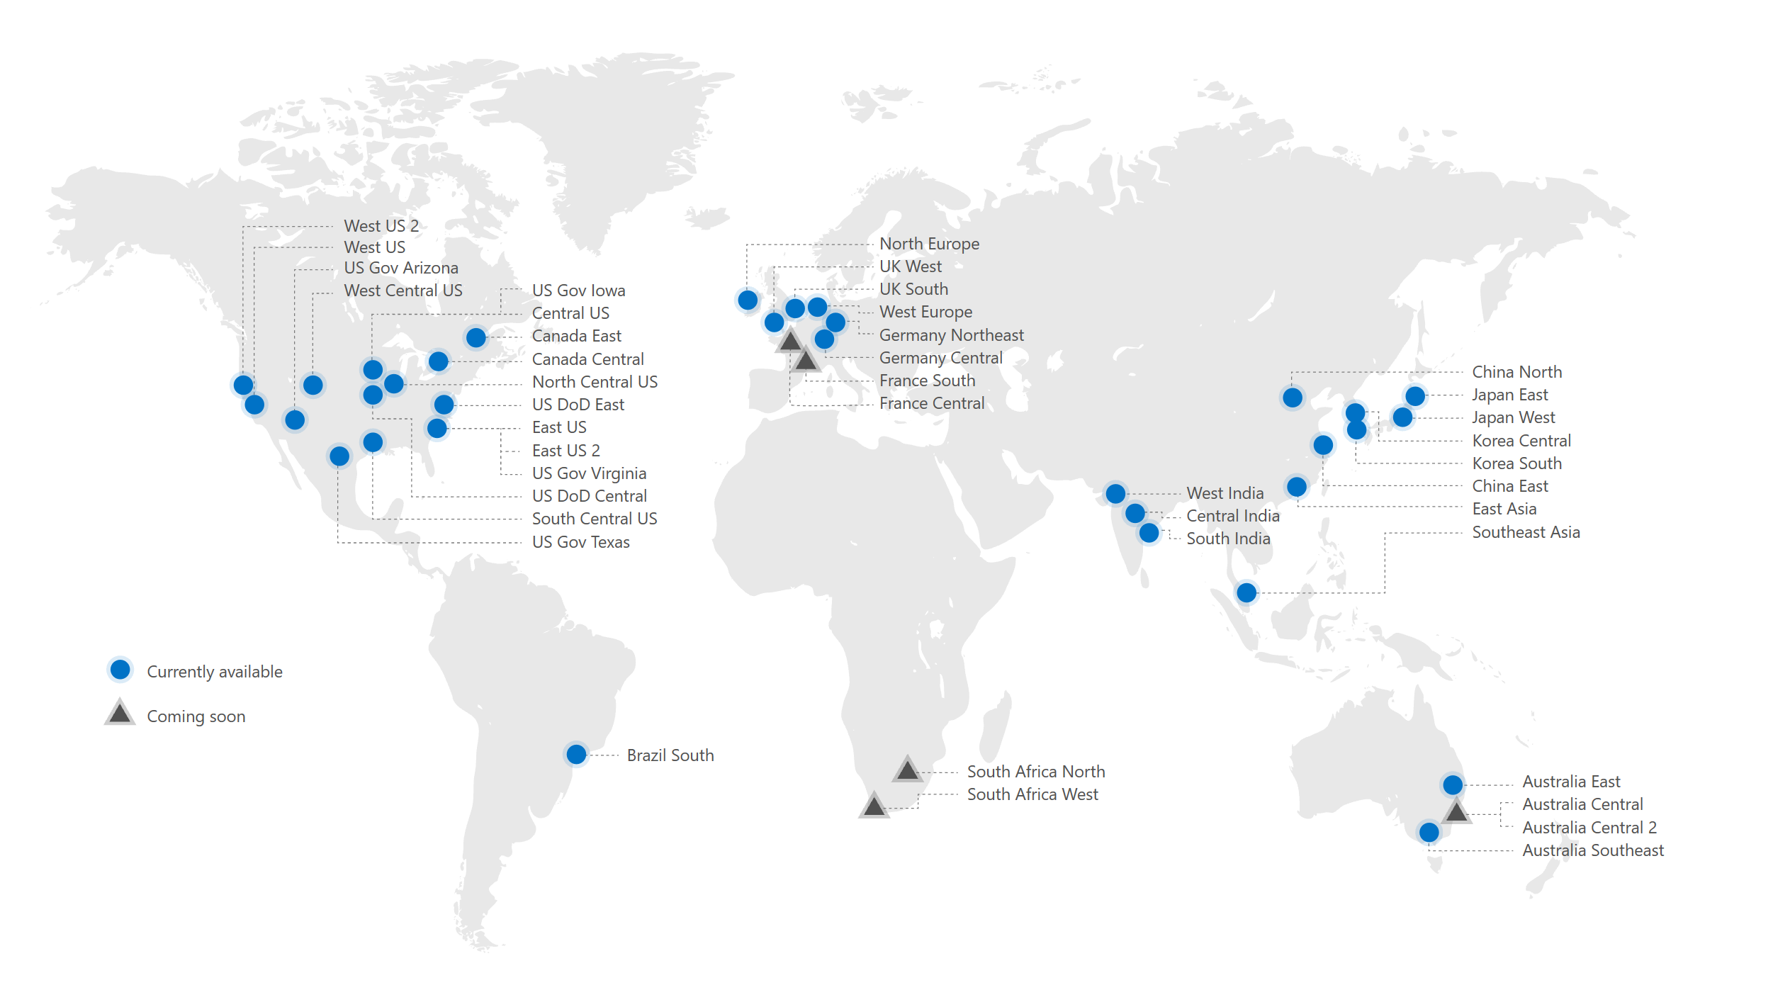
Industry-leading GLOBAL reach
30+
Azure regions available
Available
Coming
Notes:
https://azure.microsoft.com/en-us/global-infrastructure/services/?products=postgresql

Slide 51
Industry-leading GLOBAL reach
Region | Brazil South | UAE North | Canada Central | Canada East | Central US | East US | East US 2 | NC US | SC US | WC US | West US | West US 2 | West US 3
Azure Database for PostgreSQL
Azure Database for PostgreSQL flexible servers
Region | South Africa North | Central India | South India | West India | Japan East | Japan West | Korea Central | Korea South | East Asia | SE Asia | Australia Central | Australia East | Australia SE | China Non-Regional | China East | China East 2 | China North | China North 2
Azure Database for PostgreSQL
Azure Database for PostgreSQL flexible servers |  |  |  |  |  |  |  |  |  | GA expected H2 2022 |  |  |  |  |  | GA expected Q1 2022
Region | North Europe | West Europe | France Central | Germany WC | Norway East | Sweden Central | Switzerland North | UK South | UK West
Azure Database for PostgreSQL
Azure Database for PostgreSQL flexible servers |  |  |  |  |  |  |  | GA expected H2 2022

Slide 52
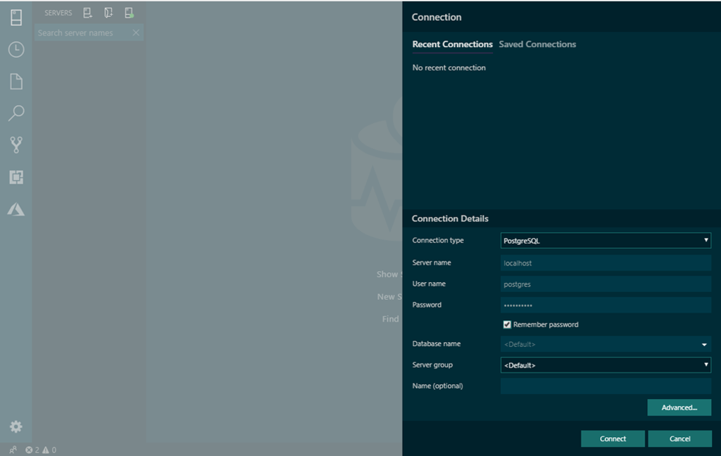
Get started with open source extensions
Connecting to PostgreSQL on Azure Data Studio
Microsoft is committed to contributing to, working with and supporting access to the Postgres community and its innovations
Microsoft contributions to the Postgres community:
Azure Data Studio PostgreSQL extension enables you to connect to, query, and develop PostgreSQL using a modern data editor
Visual Studio Code extension streamlines code editing with built-in git commands and optimization for quick code-build-debug cycles
And more, including pg_auto_failover, cstore_fdw, hll, pg_cron, topN, and Citus Community
Azure Database for PostgreSQL also supports popular PostgreSQL extensions including PostGIS, Timescale*, pg_prewarm, pg_stat_statements, and many more
* Supported on Single Server. Coming to Flexible Server in 2022.
Notes:
Azure Data Studio: An Open Source GUI Editor for Postgres: https://azure.microsoft.com/en-us/blog/azure-data-studio-an-open-source-gui-editor-for-postgres/
PostgreSQL extension (preview): https://docs.microsoft.com/en-us/sql/azure-data-studio/postgres-extension?view=sql-server-2017
PostgreSQL extensions in Azure Database for PostgreSQL – Single Server: https://docs.microsoft.com/en-us/azure/postgresql/concepts-extensions

Slide 53
Common Workload Patterns
Use Cases

Slide 54
Common workload patterns – Flexible Server
Transactional and operational analytics
JSON, geospatial support, or full-text search
Cloud Native apps with modern frameworks

Slide 55
Best practices for choosing the optimal SKU
Max connections supported scale with number of vCores and memory available per vCore
Storage IOPS scale with provisioned storage for General Purpose and Memory Optimized tier (approximately 3 IOPS per GB)
Notes:
MO are 35% more expensive than GP SKUs. If you workload needs more user concurrency, but not all these connections are active, then MO offers better price/performance and TCO. For most micro-services based architecture MO offers the best TCO.

Slide 56
Resources
Product overview
Azure Database for PostgreSQL
Other
Pricing
Documentation
Migration partners
Gear Up

Slide 57
Thank you

